Slide 1

Red Flags
Rachael Wood
MMACP, MCSP, HPC, FHEA
MSc, PgDip, PGCE, BSc(Hons)

Slide 2
ILO
By the end of this session students will be able to:
Identify red flags
Explain the clinical significance of red flags
Describe the course of action that a physiotherapist should take if red flags are present
Explain why the detection of red flags fits into the back pain care pathway

Slide 3
Reference
Greenhalgh, S., Selfe, J. and Gifford, L., 2006. Red Flags: A guide to identifying serious pathology of the spine (physiotherapy pocket books). Edinburgh: Churchill Livingstone.
Red Flag and the Red Herring!

Slide 4
Additional Reading
Greenhalgh, S. and Selfe, J., 2003. Malignant Myeloma of the Spine. Physiotherapy. 89(8) 486-488.
Greenhalgh, S. and Selfe, J., 2004. Margaret: a tragic case of spinal Red Flags and Red Herrings. Physiotherapy. 90, 73-76.
Kerry, R. and Taylor, A.J., 2006. Cervical arterial dysfunction assessment and manual therapy. Manual Therapy. 11(4) 243-253.
Kerry, R., Taylor, A.J., Mitchell, J. and McCarthy, C., 2008. Cervical arterial dysfunction and manual therapy: A critical literature review to inform professional practice. Manual Therapy 13, 278-288.
Niere, R.K. and Torney, S.K. 2004. Clinicians' perceptions of minor cervical instability. Manual Therapy. 9, 144-150.

Slide 5
Diagnostic Triage
Is this a NMS problem? Yes/No ?
Can this be helped with physiotherapy or should I refer onwards ? Yes/No ?
What are the problems I can help with ?

Slide 6
Type of pain
Sharp burning – nerve
  Tingle, Pins & Needles or numb - nerve
Deep, boring, diffuse – bone
Localised, but referred to other areas – joint
Diffuse, aching, poorly localised, referred – vascular
Dull, achey, diffuse – muscle

Slide 7
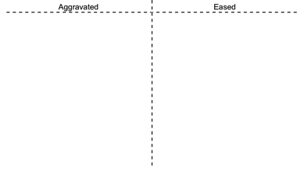

Behaviour of Symptoms
Aggravating factors
Easing factors
Severity
Irritability
Diurnal pattern
Daily Activities
Stage of condition
VAS
0 _________________ 10
APS
0 = No pain
10 = Worst pain you can
Imagine

Slide 8

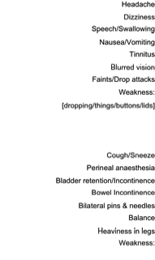
Special Questions

Slide 9

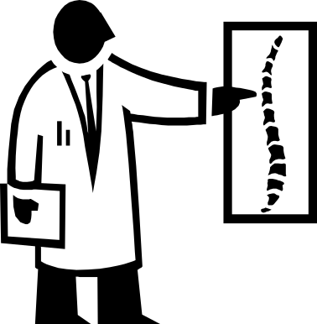
LOW BACK PAIN CARE PATHWAY
low back pain
No referral
Red flags
No red flags
refer on -
Rheumatology/ortho
PSYFs
No PSYFs
Refer on to the
‘About your back service’
Advise and reassure
Better in a week
No better in a week
Refer for mechanical
assessment

Slide 10
CSAG 1994
Five diagnostic catagories of spinal disorders
  Simple backache
  Nerve root pain
  Red Flags
  Cauda Equina
  Inflammatory disorder
Diagnostic Triage
  Simple back ache (95%)
  Nerve root pain (<5%)
  Possible serious pathology (<1%)

Slide 11
“The recognition of neoplastic disease, earlier than later, depends more on awareness, vigilance and suspicion rather than a set of rules. One must always be thinking of it, all the time and every time.”
Grieve (1994)

Slide 12
AGE
Degenerative back pain processes not present in children, possible causes of red flag LBP could therefore be: - Infective processes
    -Tumours of spinal column or cord
Children over 10 possible causes are:
  - spondylolysis, spondylolisthesis
-Scheurmann’s disease:
  -Vertebral oesteochondritis
  -Male age: 12-18, Lower Tx (T9)
  - herniated nucleus pulpous / over use syndromes / tumours
A clear link between age and cancer
Under 10
Over 50
11-19
Notes:
Scheurmanns
The disc may move forward between the cartilage end plates and anterior longitudinal ligament, producing wedging. It may produce minor Thoracic back ache and a local dorsal kyphosis maybe evident on spinal flexion

Slide 13
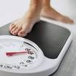
Weight loss
Red flag index of suspicion for weight loss:
    3-6 month period:
  Weight loss: 5% body weight - Mild
  Weight loss: 5-10% body weight -Mod
  Weight loss: >10% body weight -Severe
Later stages of serious pathology cachexic weight loss occurs and is drastic > 10 %.(A wasting syndrome in which fat and muscle are lost.)
Other causes: Gastro-intestinal disorders / diabetes / hypothyroidism / adrenal insufficiency / infection / malignancy / depression.
Notes:
Rapid weight loss assoc with disseminating tumours

Slide 14

Systemically unwell:
– malaise (fever / chills / UTI)
Children present with short history of systemic illness.
Adults remain asymptomatic for years – myeloma – vague aches, thirst and nausea.
Importance of viewing holistic picture and link for symptoms.
Notes:
Significance to being a red flag: Can indicate a lower resistance to infection – a symptom for example of myeloma.

Slide 15
TRAUMA:
-fall from height / whiplash / RTA
Difficult to damage lumbar spine, however cervical spine is susceptible through WAD.
Caution if no imaging has been conducted - ? Fracture.
Consider internal injuries to chest and abdomen if trauma to this area.
Head injury – consider neurological signs and symptoms.

Slide 16
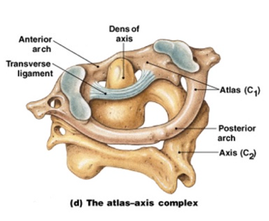

Slide 17
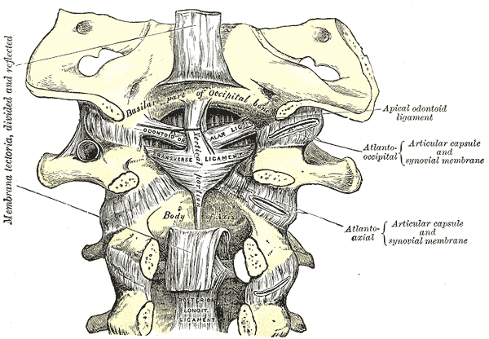

Slide 18
Cervical Instability
Alar Ligament
Transverse Ligament
Tectorial Membrane
  Neire & Torney, 2004

Slide 19
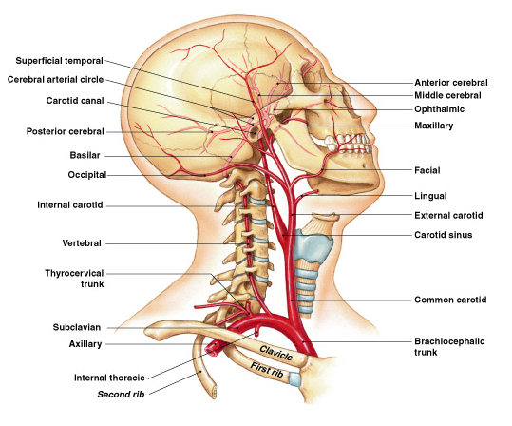

Slide 20
VERTEBROASILAR INSUFFICIENCY
(VBI)
Can lead to ischaemia in areas of brain supplied by basilar artery: the pons, medulla and cerebellum as well as central and peripheral vestibular system.
Screen for 5 D’s, plus nausea
(Dizziness, diplopia, drop attacks, dsyarthria, dysphagia)
Drop attacks can also indicate TIA or upper Cx instability
Contraindicate certain Cx techniques

Slide 21
Kerry & Taylor (2006)
Suggest indicators of vascular disease are more relevant.
  Hypertension
  Hypercholesterolemia
  Hyperlipidemia
  Hyperhomocysteinemia
  Diabetes Mellitus
  Genetic clotting disorder
  Infection
  Smoking
  Direct Vessel trauma
  Surgery or Medical intervention.

Slide 22

Bilateral pins and needles in hands and/ or feet
Unusual in true mechanical picture due to the large area of spinal canal in the Cx.
Other signs and symptoms including:
  Feeling of walking on cotton wool
  Loss of dexterity
  Diffuse non-specific weakness
  Altered sensation
  Broad based jerky gait
Indications of CNS involvement / irritation: Refer for neurological opinion
E.g. Cervical myelopathy / central disc prolapse
Notes:
Not a definitive indicator of spinal cord dysfunction – there are plausible explanations. However p/n in all 4 extremities should raise suspicion
Cervical myopathy – impingement of the spinal cord
Central disc prolapse - may encroach on the dura mater providing bi-lat symptoms

Slide 23
Constant progressive pain
Suspicious if not mechanical/ and is constant
Night pain- disturbed sleep, even with analgesia.
Suspicion with expanding pain- I.e. spreading over a number of segments.
May start as episodic and appear to respond to treatment yet still could be pathological
Sciatic pain corresponding to a specific extraspinal point is an“ alarming sign” as could indicate tumour.
Notes:
Night pain – alone is not purely significant, as mechanical symptoms could present in this manner. Yet is night pain is reported to be the most intense and severe episode experienced though out a 24hr period, then it should be considered more. As mechanical pain is normally most intense during the day during weight bearing, yet severe irritable pain could present in this manner. Night pain can be caused by turning, or psychologically disturbed sleep in yellow flag patients who get out of bed and provoke mechanical pain.

Slide 24
FAILED TREATMENT
In context 50% of LBP settles within 4 weeks (CSAG, 1994)
Consider – nature of condition, use of evidence based practice, psychosocial issues, patient compliance, patient therapist interaction – before residing to red flag factors.
Constant monitoring of general health issues is important to give vital clues.
Notes:
If treatment fails this is considered as a red flag

Slide 25
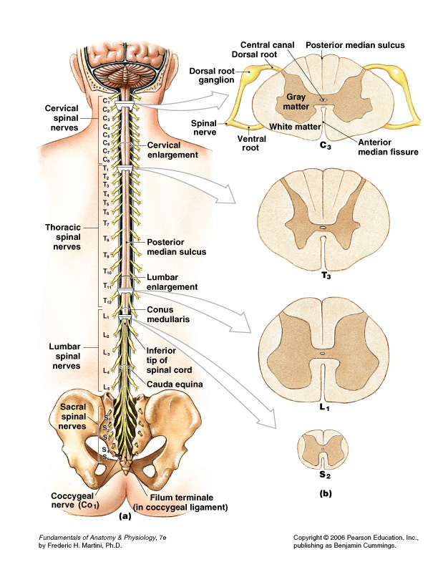

Slide 26
Cauda Equina Syndrome
Sphincter disturbance
Gait Disturbance
Saddle anaesthesia
Rare prevalence 1:50000 patients seen in primary care setting in UK (Office for National Stats 1995)
Longer delay to surgery leads to great possibility of permanent loss of function
EMERGENCY REFERRAL
Notes:
Cauda equina consists of spinal nerve roots from L1 distally – dysfunction of these roots affects motor and sensory function to the pelvic organs , pelvic floor and lower limbs.
If sacral nerve roots are injured the initial response is urinary retention and the bladder becomes flaccid - overflow incontinence.
Can present as acute or chronic- over age of 50 and stenotic in nature

Slide 27
Signs and symptoms of cauda equina syndrome in 45 patients (NG et al 2004)
Perineal numbness
Loss of urinary sensation
Urinary incontinence
Absent anal tone
Faecal soiling
Painful retention
Faecal incontinence
Percentage
86
57
46
38
15
11
9

Slide 28
Sensitivity of signs and symptoms of cauda equina ( Deyo et al , 1992)
Urinary retention
Unitaleral or bilateral sciatica
Sensory motor deficit and reduced SLR
Saddle anaesthesia
Sensitivity
0.90
>0.80
>0.80
0.75
Sensitivity: = the chance of having a positive result when the disease is present

Slide 29
Physical examination – indications of red flags:
Looks unwell
Spinal deformity/ mass
Inability to lie supine
Bizarre neurological deficit
Deviation on movement – assoc with neuro deficit
Loss of sphincter tone and altered S4 sensation
Upper cervical instability tests
+ve extensor plantar response
Disturbed gait
Notes:
Obvious signs of pain, weight loss, looking drawn.
Lumps and bumps should be checked out.
Can be due to increased pressure on affected segment
Anything that doesn’t fit a normal clinical picture should be viewed with suspicion. Lhermitte’s sign, provoked by Cx flexion, causing shooting sensation down spine +/- arms.
This does not necessarily just indicate a mechanical picture.
Cauda equina
Particular tests – that should be conducted with extreme care.
Should be included on any spinal examination – indicator of UMN involvement
Can indicate myelopathy – with LMN symptoms at level of lesion and UMN symptoms below – check for clonus

Slide 30
PATHOLOGIES – to be aware of:
Cancer, plus metastases
Pancoasts tumour
Brucellosis
TB
HIV / Aids
Osteoporosis
Visceral pain
SIJ

Slide 31

CANCER– warning signs
Change in bowel/ bladder habits
Sores that do not heal
Unusual bleeding or discharge
Thickening of lump in breast or other
Indigestion or difficulty swallowing
Obvious change in wart or mole
Nagging cough or hoarseness

Slide 32
CANCER - Metastases
Most common Primary causes:
      Breast / lung / prostate
Can get secondary metastases in vertebral bodies, ribs and ilium.
Affects vertebral body 4 times more than posterior spinal segments
30-50% destruction in vertebrae to show on x-ray
Can occur 5-20 years post initial diagnosis
  Benign tumour – remains localised
  Malignant tumour spreads
Notes:
Previous cancer is on it’s own not a red flag but boney mets can mimic mechanical pain.

Slide 33
Pancoasts Tumour
Tumour at apex of lung
Can affect lower trunks of the brachial plexus
S&S: Medial arm pain and T1 palsy / weakness of intrinsic hand muscles,+/- paraesthesia and cutaneous analgesia in ulnar aspect of the hand /
Horners syndrome = dilated pupils / drooping eye lids (ptosis) / unilateral flushing of the face.
Rapid and almost complete mortality rate (Gurwood, 1999). It causes electrolyte imbalance that results in fatal heart arrhythmias, and weaken respiratory muscles – infection. (Malzman, 2004)

Slide 34
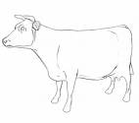
Brucellosis
Infection affecting predominantly lumbar spine.
Most commonly affects those involved with live stock and its preparation.
A bacterial infection transmitted through un-pasteurised milk or dairy products.
Symptom: Fatigue, breathlessness and sweating plus headache and LBP.

Slide 35
Tuberculosis
30% of world population currently affected.
TB infections of spine usually ‘seeded’ from lungs – site of infection normally thoraco-lumbar junction.
Features- backache with gibbus, extreme kyphosis, abscess in groin or trochanteric region of buttock, weight loss, fever, neurological compromise, malaise, skeletal involvement.
Consequence: Non traumatic spinal cord lesions
Notes:
Gibbus- sharply angled curvature of a vertebrae, resulting from collapse.

Slide 36
HIV / Aids
Immune system deterioration- increasing susceptibility to illness
S&S: SOB / Cough / Poor coordination / impaired swallow / confusion / diarrhoea / fever / vision loss / Nausea / WL / fatigue / headaches
Relationship between HIV and TB synergistically – combined effect is worse
60% HIV +ve TB patients will have skeletal involvement compared to 1% in HIV negative patients

Slide 37

Osteoporosis
Leads to increased likelihood of fracture
Likelihood of it affecting a condition, related to:
  Cortico-steroid use
  Gender - female
  Early menopause- #’s occur 10-15 years later
  History of previous fracture
  Family history of osteoporosis
Patient taking systemic steroids with LBP has specificity of 0.99 when considering vertebral compression fractures (Dukes , 2004)
Notes:
Providing no fracture has occurred, once steroid treatment is withdrawn, the effects of steroids are reversible.
I.e. The chance of them having that fracture due to the osteoporosis is 99%

Slide 38
Visceral Pain
Can produce local thoracic pain or referred pain to the
thoracic region – mimicking mechanical pain.
(Often systemic symptoms shown – not always)
Angina: chest and left arm referred
Pulmonary embolis / pleurisy / pneumothorax
Acute pancreatitis: abdo pain localised to the epigastrium and upper abdo. Can refer to mid and lower thoracic region.
Testes: Supplied by the 10th and 11th segments, therefore can refer pain here.
Aortic Anyeurism: Commonly abdominal. Present with symptoms of chronic LBP. Prone to rupture – presenting with epigastc pain that radiates through back, and haemorrhagic shock – Medical emergency.
Notes:
Key signs and symptoms for the cardiovascular system:
Pain – angina or in legs
Sweating
Palpitations
Breathlessness / cough
Light headedness / loss of consciousness
Fatigue

Slide 39
S &S requiring emergence referral to a spinal surgeon
Difficulty with micturition
Loss of anal sphincter tone/ faecal incontinence
Saddle anaesthesia about anus, perineum of genitals
Widespread (>1 nerve root) or progressive motor weakness in legs
Gait disturbance

Slide 40
Diagnostic Reasoning:
Errors that can occur:
    Faulty perception or elicitation of cues
    Incomplete factual knowledge
    Miss application of known facts to a specific situation
‘Take a step back and look at the whole picture’
Notes:
For example: a 50 year old woman presents with agonising LBP, significant night pain and sweats, and weight loss of 1 stone.
Should you be worried?
No – she is menopausal is is currently having her HRT treatment reviewed by her GP, she is looking after her 2 young grandkids and is up moving around during the night creating a mechanical flare up. She’s been dieting for the last 2 months.

Slide 41
Serious Pathology Correctly Diagnosed | Serious Pathology Misdiagnosed or Benign
Benign pathology Misdiagnosed or serious | Benign Pathology Correctly diagnosed
1 % of those with spinal pain are of a serious spinal pathology
(CSAG, 1994)

Slide 42
Conclusion
Recognition of pathology early depends on awareness, vigilance and suspicion rather than rules.
It is important to remember that red flag lists are lists of clinical indicators rather than absolute rules.
It is important to consider holistic pictures and patterns of symptoms rather than individual symptoms.
(Greenhalgh & Selfe, 2006)

Slide 43
ILO
By the end of this session students will be able to:
Identify red flags
Explain the clinical significance of red flags
Describe the course of action that a physiotherapist should take if red flags are present
Explain why the detection of red flags fits into the back pain care pathway

Slide 44
References
CSAG, 1994. Report of a Clinical Standards Advisory Group on Back Pain. London: HMSO.
Greenhalgh, S. and Selfe, J., 2003. Malignant Myeloma of the Spine. Physiotherapy. 89(8) 486-488.
Greenhalgh, S. and Selfe, J., 2004. Margaret: a tragic case of spinal Red Flags and Red Herrings. Physiotherapy. 90, 73-76.
Greenhalgh, S., Selfe, J. and Gifford, L., 2006. Red Flags: A guide to identifying serious pathology of the spine (physiotherapy pocket books). Edinburgh: Churchill Livingstone.
Grieve, G,P., 1994. The Masquaraders. In: Boyling, J.D. and Palastanga, N. (eds) Grieve’s modern manual therapy: the vertebral column, 2nd ed. Edinburgh: Churchill Livingstone
Gurwood, A.S., 1999. Horner’s Syndrome. Optometry Today. June: 36-37.
Kerry, R. and Taylor, A.J., 2006. Cervical arterial dysfunction assessment and manual therapy. Manual Therapy. 11(4) 243-253.
Kerry, R., Taylor, A.J., Mitchell, J. and McCarthy, C., 2008. Cervical arterial dysfunction and manual therapy: A critical literature review to inform professional practice. Manual Therapy 13, 278-288.
Maltzman, J.D., 2004. Developments in the fight against cancer cachexia. Online. Avaliable: http://www.oncolink.org.
Niere, R.K. and Torney, S.K. 2004. Clinicians' perceptions of minor cervical instability. Manual Therapy. 9, 144-150.
Office of National Statistics., 1995. Morbidity statistics from general practice: 4th national study 1991-1992. London: HMSO

